Slide 1
Diversity, Equity, and Inclusion
Notes:
Web version last updated 10 May 2019. Photos without attribution are under Creative Commons Licenses (CC0).
Good morning, My name is _________________ and I’m here to talk with you about the Diversity, Equity, and Inclusion Task Team. This Task Team was started in 2017 by Alex Navarro and Neha Savant, and our goal is to help PARC include all people and be equitable in opportunities and resources it provides. And, just like biodiversity is beneficial to an ecosystem, we believe that diversity in PARC is beneficial to the conservation of the critters we love.

Slide 2
Opening Thought—The Dinner Party
All uncredited images under Creative Commons License (CC0)
Notes:
To begin, let’s imagine we’ve been invited to a dinner party. What is the advice that is always given? Don’t talk about politics, religion, money, health, or physical appearance. Really it means don’t talk about many aspects of who we are. Imagine instead someone asked you, “Are your finances similar to your parents?”; or “Why do you look the way you do?”
Hearing these questions would certainly me make me feel uncomfortable, and maybe it makes you a little uncomfortable, too. Discussing aspects of our identity can be challenging—we don’t get much practice—but we need to discuss these topics, especially as an organization.

Slide 3
Our purpose here today
Define inclusion, equity, and diversity
Explain why it is important to PARC
Recognize there are currently barriers to full participation in our field
Participate in PARC’s current initiatives to address these barriers
Let’s start this discussion!
Notes:
Our purpose today is to explore some of these challenging ideas. By the end of the talk this morning I hope we can all
Define inclusion, equity, and diversity
Explain why it is important to PARC
Recognize there are barriers to participating in our field
Participate in PARC’s current initiatives to address these barriers
But most importantly, the purpose is to begin these discussions at PARC!

Slide 4
Sectors represented in
n = 139
From DEITT Demographic Survey
Notes:
One of the reasons that PARC is such an effective organization for conserving reptiles and amphibians is because of the experience and expertise of our partners. This diversity helps us navigate complex problems, but someone’s career is just one part of their identity.

Slide 5
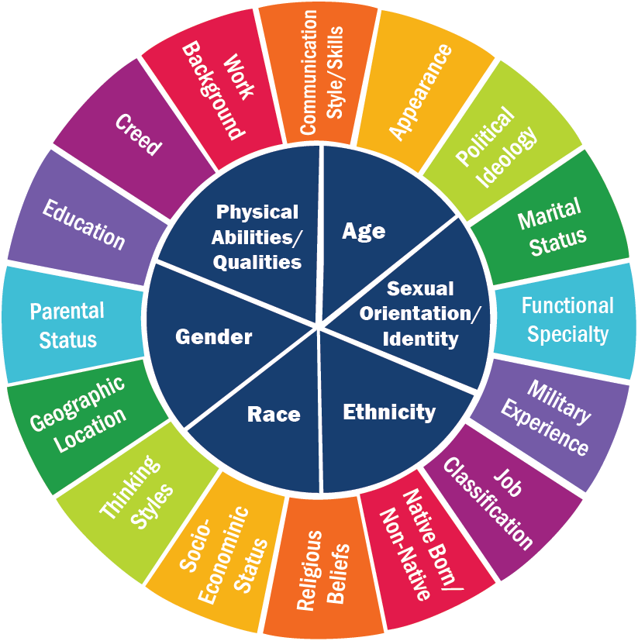
Identity is Complex
Image from RIT
Notes:
One of the main reasons discussing diversity, equity, and inclusion can be so difficult is because identity complex. There are so many dimensions to each and everyone of us. Some of our dimensions may be visible to others, and some of them are unseen.

Slide 6
Aspects of My Identity
Latinx
Mixed
Chicano
Male
Scientist
Ecologist
College Educated
Introvert
Young
Notes:
To make things more concrete, I would like to share with you a few ways in which I identify. (Work through circle quickly). Each of these are also nuanced. For instance, I might identify as a scientist within a broader group, but within science I identify as an ecologist. Or broadly I may identify as Latinx, but at a deeper level I identify as mixed race and Chicano.
There are many dimensions and layers of diversity within a single person. In many of the ways I identify I have privilege (college educated, male). In some of the ways I identify I have experienced barriers. This is likely true for everyone in this room.
******************************************************
****** This slide is to be filled out by presenter *****
******************************************************

Slide 7
Diversity
A group’s collective identity
traits, experiences,
and perspectives
Image from RIT
Notes:
Now that we know a little more about identity, let’s define diversity, equity, and inclusion. [Read slide]. For PARC, it’s about acknowledging that people are different, and rather than downplaying those differences, it is about celebrating them.

Slide 8
Inclusion
Intent/action to include those otherwise excluded or marginalized
Exclusion
Separation
Integration
Inclusion
Notes:
Inclusion means intent to include those otherwise marginalized.
Let’s work through the figure here. In Exclusion, the orange dots are kept on the outside. In Separation the orange dots get their own circle now, but it is smaller. In integration, the orange dots are included in the larger circle, but there are still barriers to full participation in the larger circle. Inclusion means no barriers. For PARC that means everyone feels like they are welcome and involved.

Slide 9
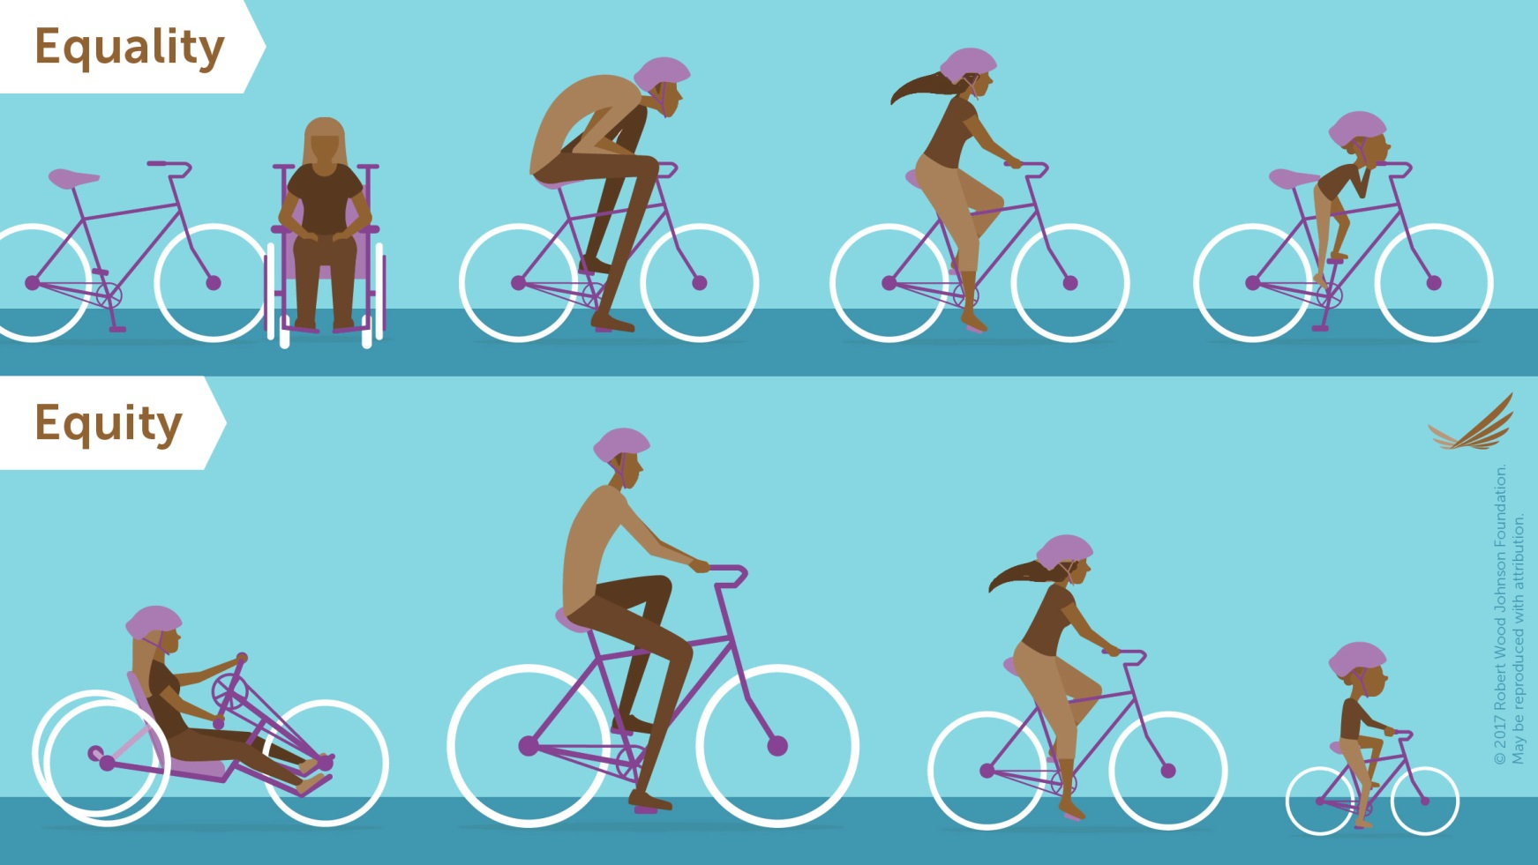
Equity
Equal access, power, and outcomes for all
© Robert Wood Johnson Foundation
Notes:
Lastly, equity mean equal access, power, and outcomes for all.
Equity is different than equality. In equality, everyone is given the same thing because it is fair. In this case it is a same-sized bike. However, the person using the wheelchair can’t use that bike. The tall person looks uncomfortable. The child can barely fit on it.
In equity, not everyone is given the same thing. They are given what they need to ride a bike—whether a hand-powered bike (wheel-chair), a large bike, or a small bike. For PARC, this means meeting people where they are so they can participate fully in all PARC has to offer.

Slide 10
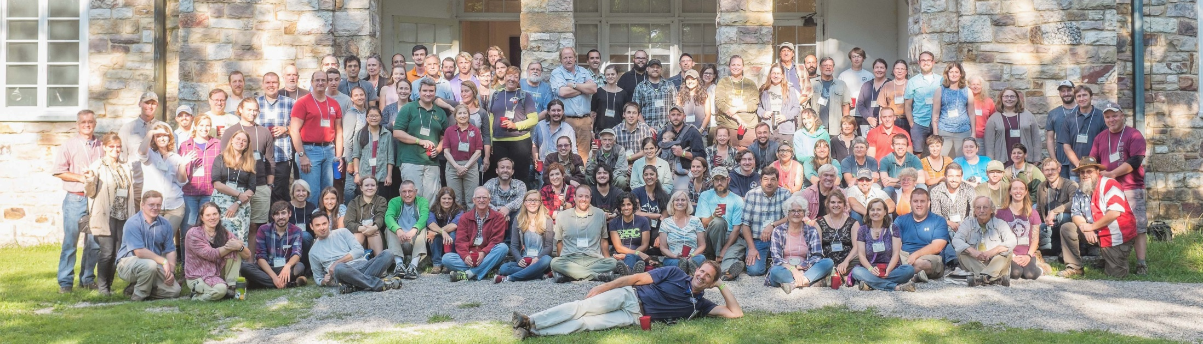
Strengthening PARC
An inclusive and equitable PARC means better member and partner recruitment, engagement, and retention
Riordan, HBR, “Diversity is Useless without Inclusivity”
Notes:
So why should we be inclusive, equitable, and diverse? Not only is it the right thing to do, but there is so much to gain!
Being inclusive and equitable helps us recruit new partners/members. Maybe we are one connection away from our next big success.
Inclusion means better member engagement. Inclusion makes folks feel like their contributions matter, motivates individuals to participate, and improves team dynamics.
Finally, look at all these happy NEPARCers. By being intentional about inclusion, we can make each meeting better and better. Wouldn’t it be awesome if PARC meetings were –the- meeting to attend? Better member retention means the conservation dream team stays together!
*******************************************************
*** This slide is to be modified by region/chapter ***
*******************************************************

Slide 11
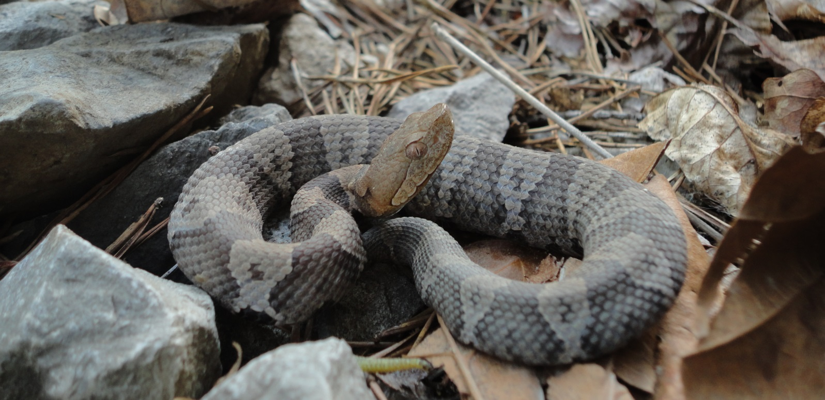
Improving PARC Success
A Diverse PARC will be more productive, more creative, and better at problem solving.
Photo by David Muñoz
Galinsky et al. 2015, “Maximizing the Gains … of Diversity”
Notes:
And, when you’ve got the conservation dream team, PARC will be more successful. It has been demonstrated in many fields that diverse teams are more productive, creative, and effective at problem solving than homogenous ones. We have many challenges ahead of us. For example, the conservation of our venomous friends like the copperhead. To address these issues we need to be as effective as we can.

Slide 12
Despite Benefits, Missing the Mark
According to the U.S. Census 2017 Estimate:
50.8% of the population identifies as female
39.3% of the population identifies racially/ethnically as non-majority
2016¹
30.1% Women
8.4% Non-majority
¹ASIH Blog ; ²Kohl et al. 2017 Professional Diversity…; ³Beck et al. 2014 Diversity at 100…
Notes:
Despite the benefits of being diverse, we’re missing the mark as a field. Aspects of people’s identity may influence whether they end up in herpetology, conservation, or the STEM fields at large.
Looking at the nation, over 50% is female and nearly 40% is non-majority (non-white) in terms of race/ethnicity.
BUT, let’s look at some of the professional societies. 1) ASIH is Much lower. Similar numbers for TWS & ESA.
Clearly there is a mismatch between our nation’s demographics and the demographics of our professional societies.

Slide 13
Why does our field ≠ our nation?
Possible explanations:
Is it intrinsic? Some identities are inherently unfit for our field
Is it extrinsic? There are barriers, intended or unintended, preventing full participation
(Eugenics!)
Notes:
So when we ask ourselves, why does our field not equal our nation? There are two possible explanations.
1) Is it something intrinsic to those identities? Are whole groups of people not wired to succeed?
Or
2) Is it something extrinsic. Are there barriers, intended or unintended that are preventing full participation in our field?
I’m gonna get in your face here for a second because the first is essentially eugenics, where science was used to erroneously identify inferior traits to create exclusion and subjugation. So either you believe in eugenics, or you believe that there are extrinsic barriers.

Slide 14
Sexual Orientation
# Respondents
LGBTQ students less likely to stay in STEM compared to heterosexual peers
(Hughes 2018, “Coming Out in STEM”;
Figure from Barres et al. 2017, “Coming Out: The experience…”)
Notes:
For example let’s look at sexual orientation as an aspect of identity. A survey of Lesbian, Gay, Bisexual, Transgender, or Queer life scientists (LGBTQ for short) evaluated how open they where about their sexual orientation, where 0 is no one knows, and 5 is everyone knows their orientation. The blue color indicates openness to friends and family, and red indicates openness to colleagues and coworkers.
We see that at higher levels of openness, the right side of the graph, LGBTQ students are more comfortable being open to friends and family than colleagues: blue is higher than red. At the closed side of the graph, the left side, the red bars are always higher, showing less openness to colleagues.
When asked why, respondents said they feared negative repercussions on their career and being alienated from co-workers based on sexual orientation. Negative repercussions on their career and alienation for coworkers (repeated for emphasis).
It is no surprise then that LGBTQ students are less likely to stay in STEM compared to their heterosexual peers.
The toxic professional environment is a real barrier to LGBTQ participation in STEM.
*******************************************************
*** This slide can be exchanged, see slides @ end ***
*******************************************************

Slide 15
Every perspective,
every experience,
and every person has something to contribute.
Diversity is being invited to the party. Inclusion is being asked to dance.
-Vernā Myers
Notes:
This is some heavy stuff. At PARC we want you to know that every perspective, experience, and person has something to contribute.
We must first acknowledge that there are issues in order to find ways to address them.
At the end of the day, it comes down to this quote. [read quote]. We hope that everyone gets invited to the party that is PARC and that everyone gets asked to participate. When they do, great things happen..

Slide 16
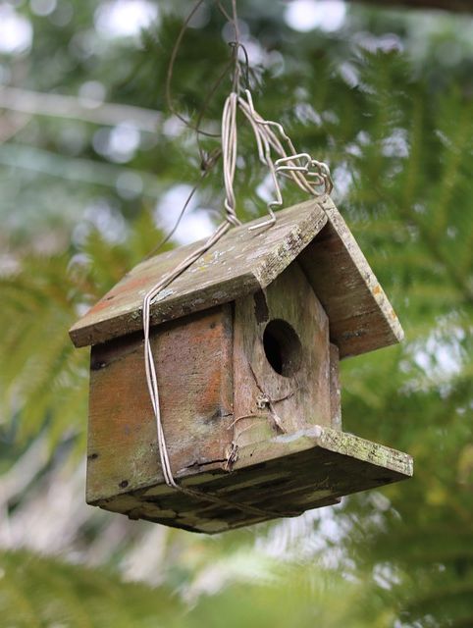
Improving Conservation Success
“Protecting nature in Massachusetts for people and wildlife”
MA Audubon Society
Tailored Education Programs
Lawrence, MA;
90% Latino
Median income <$14k
What actions could they take?
Notes:
For example, in our region we can look at the MA Audubon Society. Their goal is to (read quote) and provide tailored education programs to help achieve that goal. They wanted to expand their programming to Lawrence, MA (read stats). What actions could they take?
The traditional approach would be to go in and just offer bird programming and hope that it was effective. Maybe tell them to make their yards bird friendly. Instead, they worked with community leaders to identify needs in the community. Folks needed access to produce (food desert), so Audubon helped support local community gardens. After establishing relationships, they then had an opportunity to talk about native plants in the gardens and how those plants help migrating birds. By diversifying their input, MA Audubon went from being mildly effective to having lasting impacts on relationships in the communities they serve.
*******************************************************
*** This slide is to be modified by region/chapter ***
*******************************************************

Slide 17
Success for PARC
Meeting Champions!
Diversity Statement and Code of Conduct
This presentation
An ally at regional/ state chapter meetings
Supporting participants in our new scholarship award program
Survey on identity and meeting atmosphere
Notes:
We want the same conservation success here at PARC. By being inclusive, equitable, and diverse, we can not only make PARC more meaningful for participants, but we can advance our conservation efforts.
One of the main ways we are aiming to achieve this is through our meeting champions. Our champions are to serve as a resource and ally to uphold PARC’s Diversity Statement and Code of Conduct, support attendees, and give this presentation. They will also support our conference attendees that will be part of the task team’s new travel award that will be rolling out for next year’s meetings.
We also are learning about our PARC community to ensure we have ways of measuring our success and getting your feedback on our journey towards an inclusive, equitable, and diverse PARC.

Slide 18
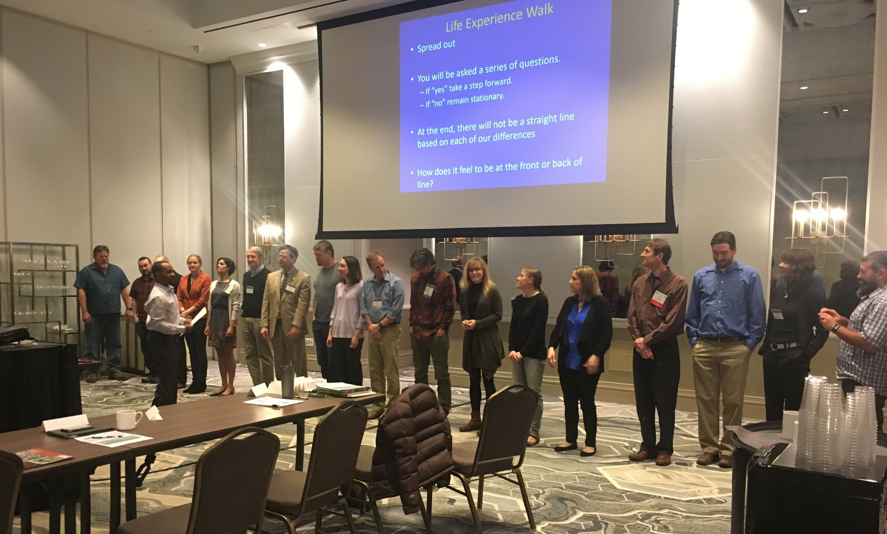
Success for PARC
Cultural Competency Training for PARC’s Joint National Steering Committee
Notes:
Not only are we trying to engage with our partners at meetings, we are also working with PARC leadership by providing cultural competency training for the Joint National Steering Committee.

Slide 19
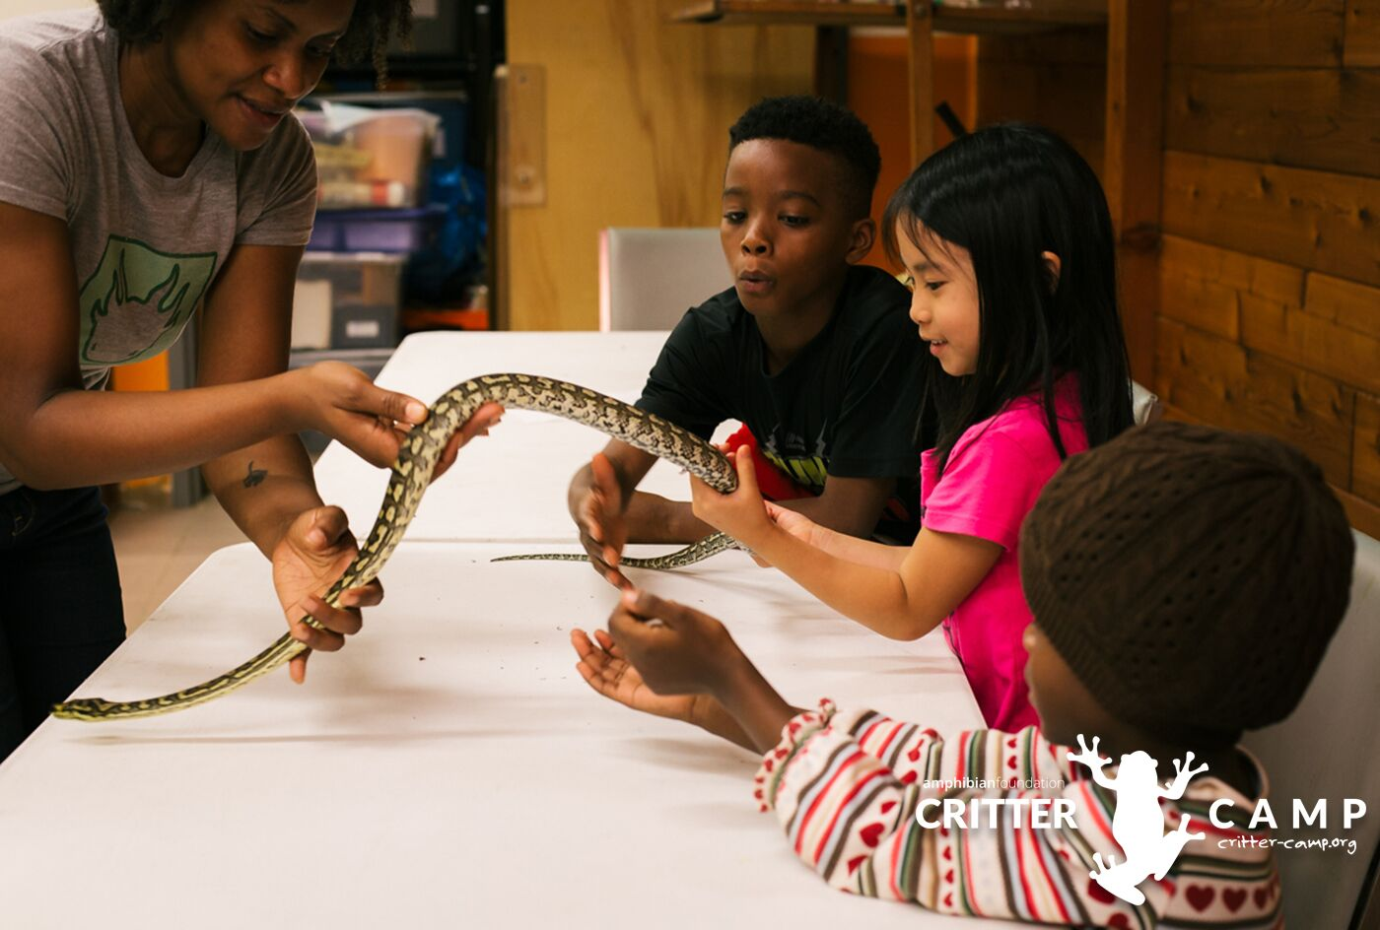
Success for PARC
Supporting youth outreach to underserved communities
Notes:
We are also receiving funding through the Amphibian and Reptile Conservancy, PARC’s funder, to support youth outreach in underserved communities. Our first partner was the Amphibian Foundation’s Critter Camp in the Atlanta Area.

Slide 20
Success for PARC
Amplifying the voices of scientists @herpetALLogy
Notes:
Finally with are amplifying the voices of our members through our twitter account @herpetALLogy.
We hosted weekly takeovers by scientists who want to share their stories, reaching well over 2,000 people.

Slide 21
Thank you for joining the conversation!
Define inclusion, equity, and diversity
Explain why it is important to PARC
Recognize there are currently barriers to full participation in our field
Participate in PARC’s current initiatives to address these barriers
Notes:
As we wrap up here, I want to say thank you. These conservations can be uncomfortable, but it is so important we start having them at PARC. Hopefully now, you feel like you can:
Define inclusion, equity, and diversity
Explain why it is important to PARC
Recognize there are barriers to participating in our field
But, we still haven’t covered this last one!

Slide 22
How will you help PARC be more inclusive, equitable, and diverse?
Start these conversations!
Discuss this talk with someone at this meeting
Network outside your group (e.g. a meal with someone new)
Listen to those you meet and remember who they are!
diversity@parcplace.org
@herpetALLogy
Notes:
My challenge to you is, how will you help PARC be more inclusive, equitable, and diverse?
If you remember our dinner party, the first step is to really join the discussion. You can do that in multiple ways.

Slide 23
Slides that could be exchanged or added

Slide 24
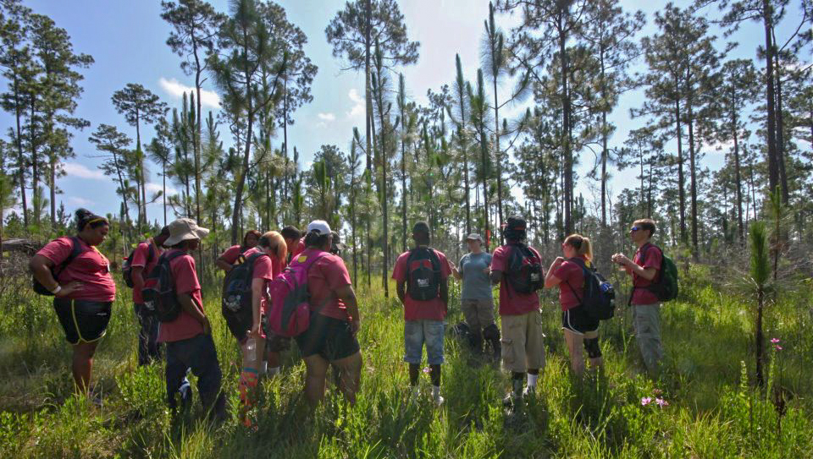
Diversity, Equity, Inclusion and the PARC Vision
“A society where amphibians and reptiles are valued…”
Photo Courtesy of Marks McWhoter
Notes:
PARCs mission is to create proactive partnerships and that means making connections and cultivating them to enact effective conservation. PARC’s vision is, “A society where amphibians and reptiles are valued…”
The ideas of inclusion, equity, and diversity are inherent to our organization’s vision. Making herps valued by society requires engagement with everyone. With that, thank you for joining the discussion!

Slide 25
Women and Field Work
65% of field scientists report sexual harassment
Women 3.5 times more likely to be targeted
21% of field scientists report sexual assault
Women 5 times more likely to be targeted
Photo by David Muñoz
Clancy et al. 2014, PloSOne
Notes:
For example let’s look at sexual identity as an aspect of identity.
Field work is one of the hallmarks of being in herpetology and conservation. Who doesn’t love getting to go into the woods to find critters like this red salamander? However, women are 3.5 times more likely to be the target of sexual harassment and are five times more likely to be the target of sexual assault while in the field. Are women less fit to be in our discipline? Or, are these attitudinal, verbal, and physical realities a barrier that prevent women from entering our field and hinder their success?
*******************************************************
*** This slide can be exchanged, see slides @ end ***
*******************************************************

Slide 26
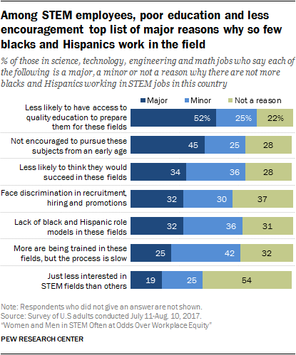
Blacks and Hispanics Employed in STEM
Notes:
For example let’s look at race and ethnicity as an aspect of identity. The Pew Research Center found that the main barriers preventing Blacks and Hispanics from participating in STEM fields were access to quality education and the lack of encouragement to pursue STEM subjects followed by discrimination and lack of Black and Hispanic role models.
*******************************************************
*** This slide can be exchanged, see slides @ end ***
*******************************************************

Slide 27
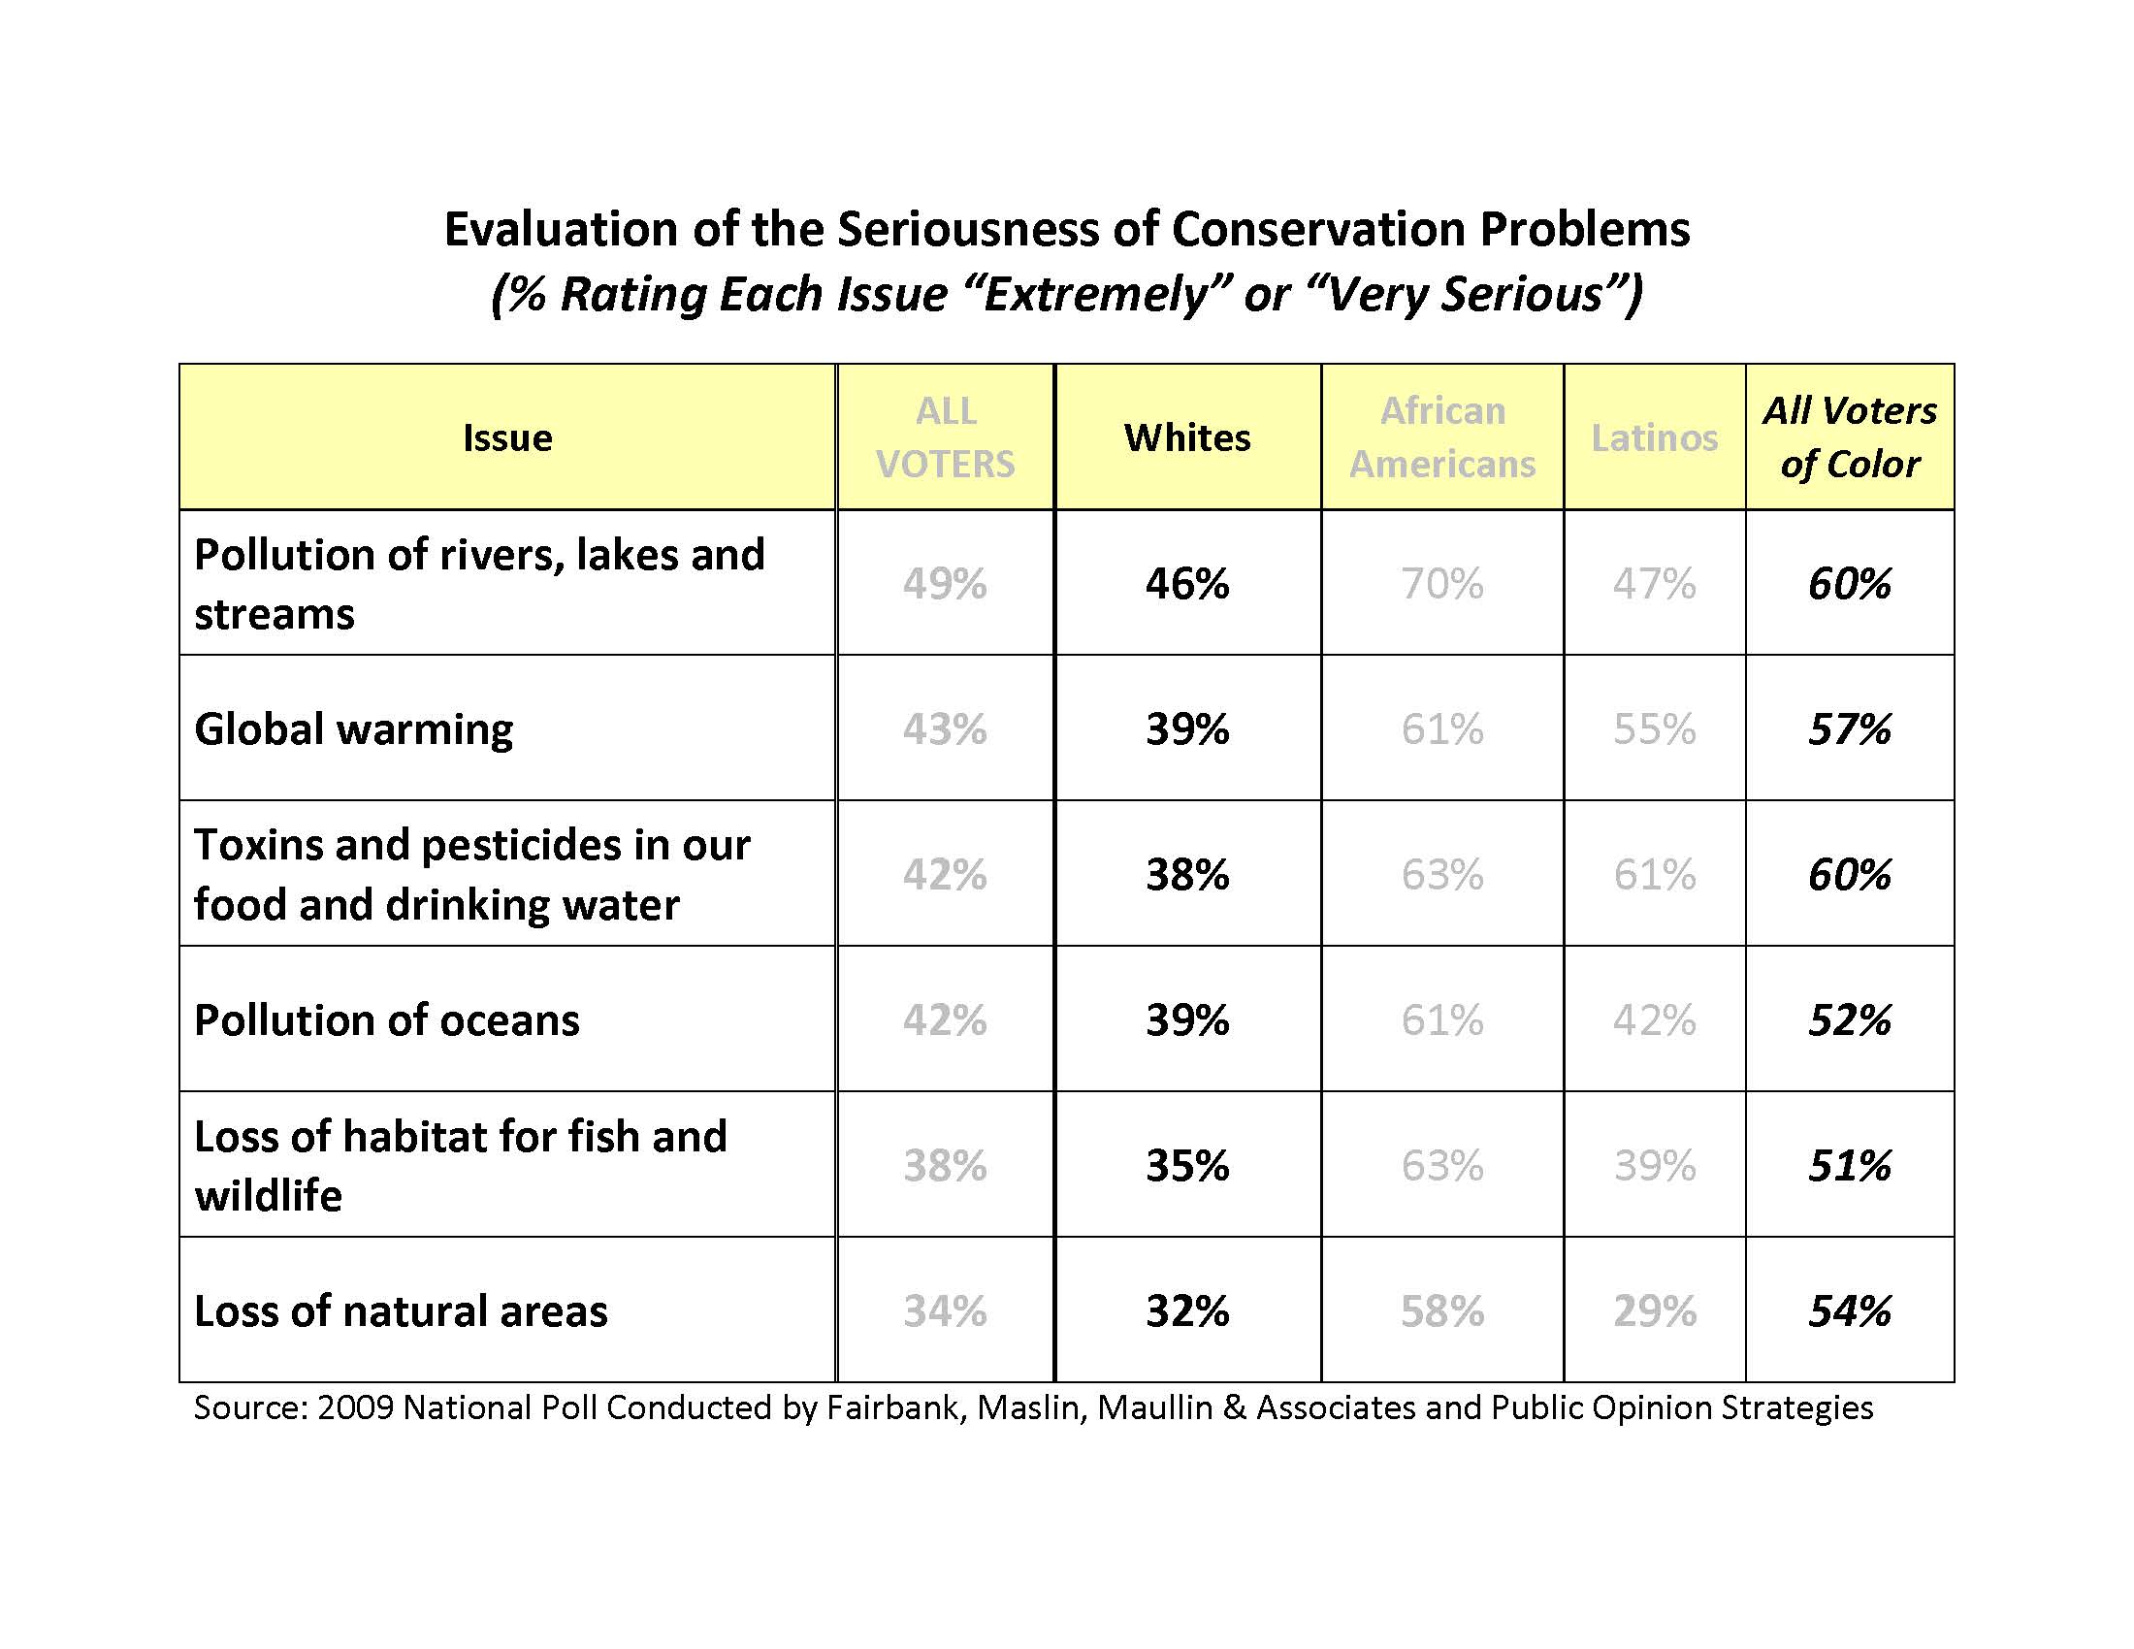
Notes:
Compare that to a poll assessing white and non-majority views of the environment. Blacks and Hispanics are more likely to identify environmental issues as important. Are Blacks and Hispanics less suited for STEM? Or are the barriers from the previous slide the real reason?
*******************************************************
*** This slide can be exchanged, see slides @ end ***
*******************************************************

Slide 28
“Is science only for the rich?” (Nature, 2016)
40% of lowest income bracket do not enroll in college
Low-income 2x as likely to not graduate college compared to higher-income students
First-generation 3x as likely to not graduate compared to students with college educated parents
Tinto 2012, Completing College; Gorski 2013, Reaching…Students in Poverty
Notes:
For example, lets look at income level as an aspect of identity. In our field it is exceedingly rare to establish your career without a college degree. This topic was discussed in the Journal Nature with the title “Is science only for the rich?”, and we see that high school students from our lowest income bracket are likely not to enroll in college (40%). Those that do are twice as likely not to finish their degree, and if their parents aren’t college educated, they are 3x as likely not to finish their degree. So are low-income students just not fit for our field, or are there barriers that may prevent their success?
*******************************************************
*** This slide can be exchanged, see slides @ end ***
*******************************************************

